Slide 1
Nutrients and Nutrition
Objective: To summarize functions, sources, and consequences of too little of the core nutrients.

Slide 2
What is Nutrition & Wellness?
Nutrition is the study of how your body uses the food that you eat.
Wellness is a philosophy that encourages people to take responsibility for their own health. It is reflected in your attitudes and your behaviors. It is the state or condition of being in good physical and mental health: "stress affects every aspect of wellness".

Slide 3
What is a Nutrient?
A nutrient is a chemical substance in food that helps maintain the body. Some provide energy. All help build cells and tissues, regulate bodily processes such as breathing. No single food supplies all the nutrients the body needs to function.
There are Macronutrients & Micronutrients

Slide 4
6 Classifications of Nutrients:
Vitamins
Minerals
Water
Protein
Carbohydrates
Fats
Sugars
Starches
Cellulose

Slide 5
Macronutrients
Macronutrients are nutrients that provide calories or energy.
Calorie: A unit of measure for energy in food. The amount of energy needed to raise the temperature of 1 gram of water through 1 °C.
Nutrients are substances needed for growth, metabolism, and for other body functions. Since “macro” means large, macronutrients are nutrients needed in large amounts.
There are three macronutrients:
Carbohydrate
Protein
Fat

Slide 6
Macronutrients
While each of these macronutrients provides calories, the amount of calories that each one provides varies.
Carbohydrate = 4 calories per gram. Protein = 4 calories per gram. Fat = 9 calories per gram.

Slide 7
Micronutrients
Micronutrients often referred to as vitamins and minerals, are only required by the body in small amounts. They enable the body to produce enzymes, hormones and other substances essential for proper growth and development, disease prevention, and wellbeing.
Micronutrients are not produced in the body and must be derived from the diet.
Deficiencies in micronutrients such as iron, iodine, vitamin A, folate and zinc can have devastating consequences.
At least half of children worldwide ages 6 months to 5 years suffer from one or more micronutrient deficiency, and globally more than 2 billion people are affected*.
* http://www.cdc.gov/immpact/micronutrients/; Investing in the future: A united call to action on vitamin and mineral deficiencies. Global Report 2009 p. 1 http://www.unitedcalltoaction.org

Slide 8
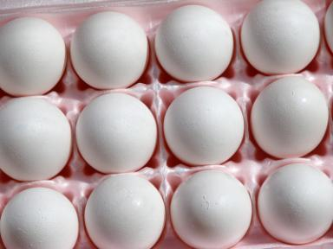
Protein
Functions
Builds and repairs body tissue and muscle
Helps to fight infection
Builds immune system
Secondary source of energy
Sources
Protein group including meat, fish, poultry, eggs, beans, nuts
Dairy group including milk, yogurt, cheese
Consequences of too little:
Weak body
Lethargy
Copyright © Notice: The materials are copyrighted © and trademarked ™ as the property of The Curriculum Center for Family and Consumer Sciences, Texas Tech University.

Slide 9
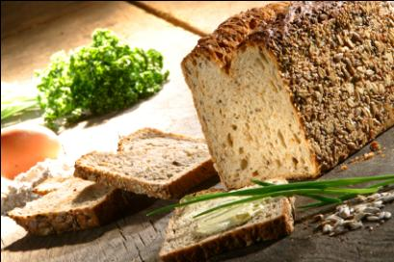
Carbohydrate
Functions
Primary source of energy
Aids digestion
Sources
Fruit group
Vegetable group
Grains group
Consequences of too little:
Lethargy, fatigue
Constipation
Copyright © Notice: The materials are copyrighted © and trademarked ™ as the property of The Curriculum Center for Family and Consumer Sciences, Texas Tech University.

Slide 10
Fats
Functions
Stores fat soluble vitamins A, D, E, K
Prevents injury to internal organs
Concentrated energy (9 Calories/gram)
Sources
Protein group including meat, fish, poultry, eggs, beans, nuts
Dairy group including milk, yogurt, cheese (if eat whole milk products)
Fried foods, pastry, junk food
Consequences of too little:
Loss of fat soluble vitamins
Copyright © Notice: The materials are copyrighted © and trademarked ™ as the property of The Curriculum Center for Family and Consumer Sciences, Texas Tech University.

Slide 11
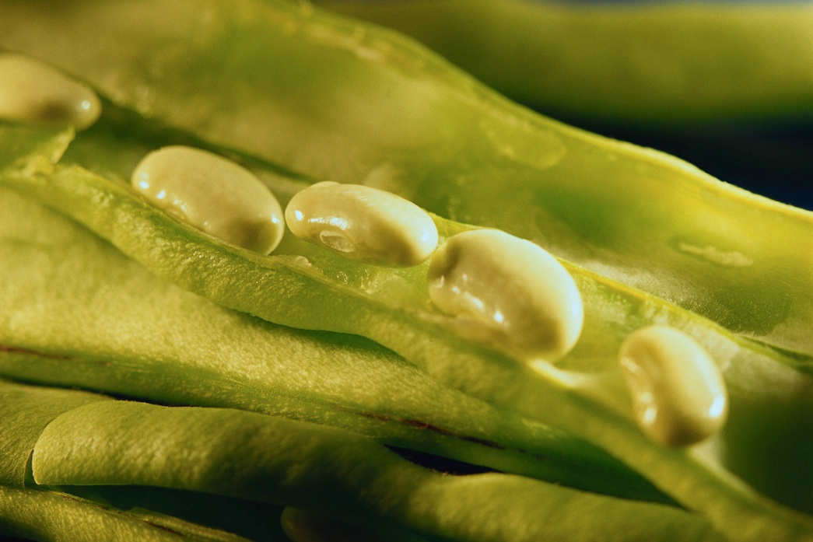
Vitamin A
Functions
Good eyesight
Provides antioxidants which fight cancers
Helps the skin
Sources
Dark orange, yellow, red, green fruits and vegetables
Liver, whole milk products
Prevents
Poor eyesight
Bad skin
Copyright © Notice: The materials are copyrighted © and trademarked ™ as the property of The Curriculum Center for Family and Consumer Sciences, Texas Tech University.

Slide 12
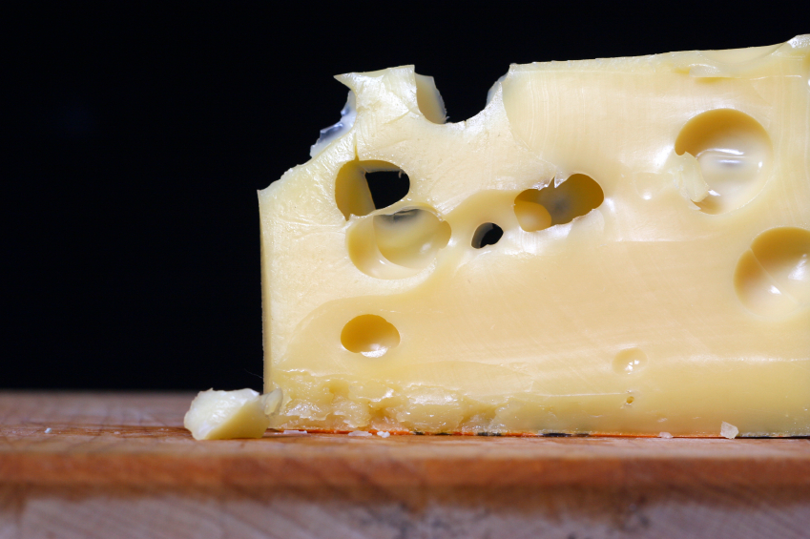
B-Complex Vitamins
B1 (thiamin), B2 (riboflavin), and niacin
Functions
Healthy nervous system
Energy
Sources
Protein group
Grains group
Dairy group
Consequences of too little:
Beriberi, pellagra
Faulty nervous system
Copyright © Notice: The materials are copyrighted © and trademarked ™ as the property of The Curriculum Center for Family and Consumer Sciences, Texas Tech University.

Slide 13
Folic Acid
Functions
Brain functions
Particularly important for: unborn babies (pregnant women need 400-800 mcg/d)
Sources
Green leafy vegetables (kale,broccoli, asparagus, etc.)
Beans (lentils)
Consequences of too little:
Brain damage/disability
Spina Bifida
Copyright © Notice: The materials are copyrighted © and trademarked ™ as the property of The Curriculum Center for Family and Consumer Sciences, Texas Tech University.

Slide 14
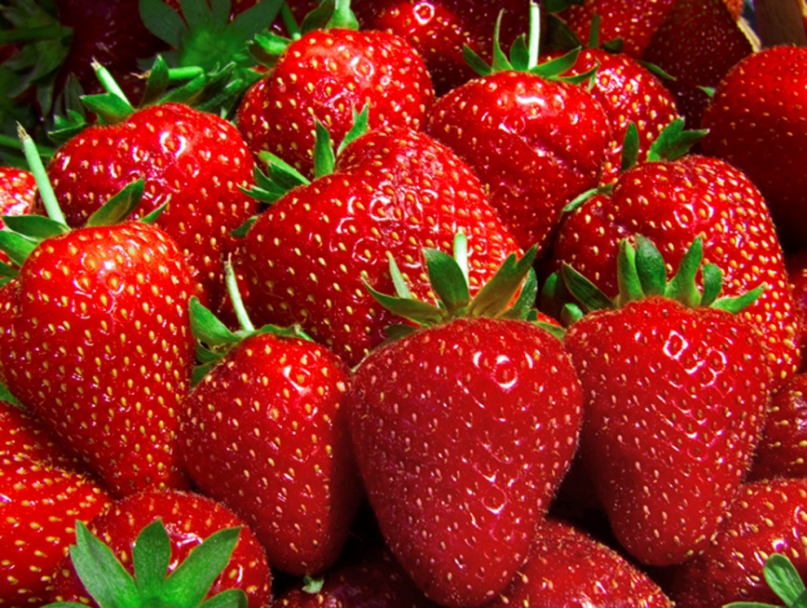
Vitamin C
Function
Builds healthy gums, teeth, and bones
Sources
Fruit group—citrus fruits are best, and strawberries, tomatoes
Potatoes, green leafy vegetables, peppers
Consequences of too little:
Scurvy
Bruising
Copyright © Notice: The materials are copyrighted © and trademarked ™ as the property of The Curriculum Center for Family and Consumer Sciences, Texas Tech University.

Slide 15
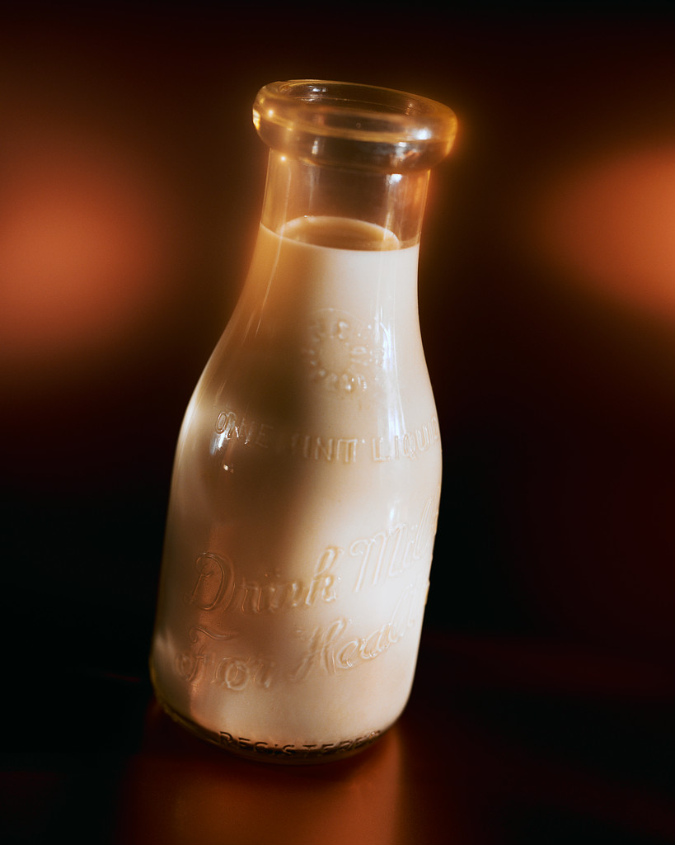
Calcium
Functions
Builds bones and teeth
Regulates heartbeat
Sources
Diary group
Green leafy vegetables (kale, broccoli)
Consequences of too little:
Osteoporosis
Weak bones/rotten teeth
Copyright © Notice: The materials are copyrighted © and trademarked ™ as the property of The Curriculum Center for Family and Consumer Sciences, Texas Tech University.

Slide 16
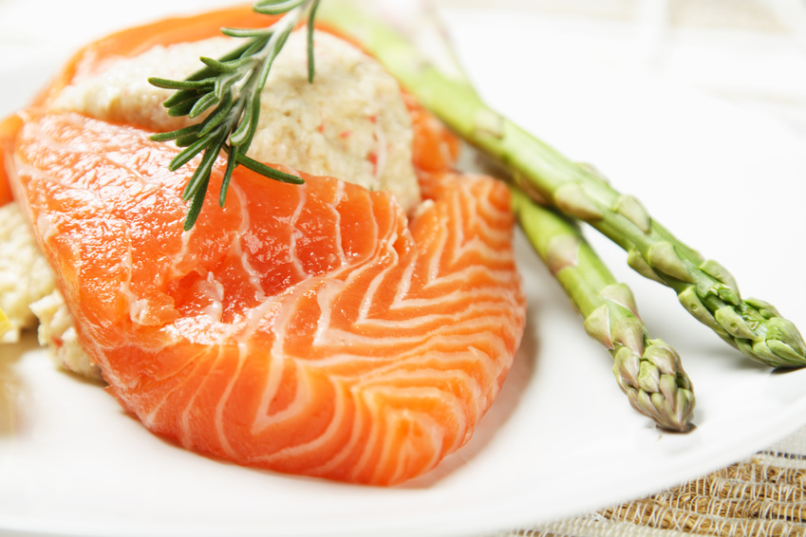
Iron
Functions
Builds hemoglobin (red blood cells)
Sources
Protein group
Heme iron – animal sources
Non-Heme iron – plant sources
Consequences of too little:
Anemia
(Not enough healthy red blood cells to carry adequate oxygen to your tissues. May result in feeling tired and weak. )
Copyright © Notice: The materials are copyrighted © and trademarked ™ as the property of The Curriculum Center for Family and Consumer Sciences, Texas Tech University.

Slide 17
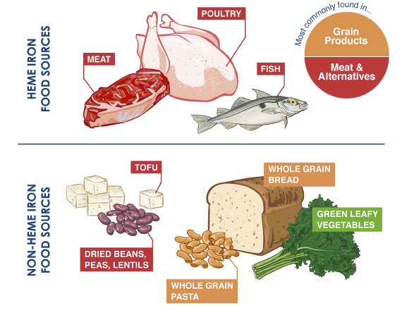
Heme vs. Non-Heme Iron
Heme-Iron is found only in meat, fish and poultry and is absorbed much more easily than Non-Heme Iron, which is found primarily in fruits, vegetables, dried beans, nuts and whole grain products.

Slide 18
Non-Heme Iron Absorption
Factors that increase iron absorption from non-heme foods:
A good source of vitamin C (ascorbic acid) - i.e., oranges, grapefruits, tomatoes, broccoli and strawberries, eaten with a NON-HEME food
A HEME and NON-HEME food eaten together
A NON-HEME food cooked in an iron pot, such as a cast iron skillet
Factors that decrease non-heme iron absorption:
Large amounts of tea or coffee consumed with a meal (the polyphenols bind the iron).
Excess consumption of high fiber foods or bran supplements (the phytates in such foods inhibit absorption).
High intake of calcium - take your calcium supplement at a different time from your iron supplement.

Slide 19
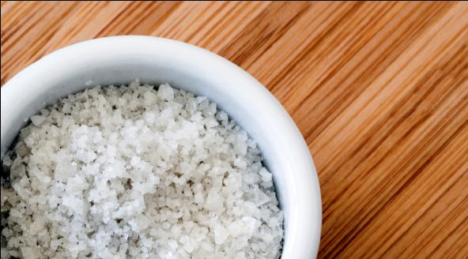
Iodine
Function
Aids the thyroid to control metabolism
Sources
Seafood
Vegetables grown in iodine rich soil
Iodized salt (US in 1924)
Consequences of too little:
Goiter
Copyright © Notice: The materials are copyrighted © and trademarked ™ as the property of The Curriculum Center for Family and Consumer Sciences, Texas Tech University.

Slide 20
Zinc
Functions
Important for normal skin, bones, and hair
Aids all systems in the body
Sources
Oysters, liver, beef, wheat products, poultry, pork, nuts, yellow cheese
Consequences of too little:
Stunted growth
Delayed healing of
wounds
Copyright © Notice: The materials are copyrighted © and trademarked ™ as the property of The Curriculum Center for Family and Consumer Sciences, Texas Tech University.

Slide 21
Group Activity
Nutrient Advertisement
You will develop a nutrient magazine advertisement and “sell” it to the class.
Divide into small groups of 2 or 3.
Use nutrition sources, and Web sites, such as the Academy of Nutrition and Dietetics at www.eatright.org, www.choosemyplate.gov, or other credible sources (NOT Wikipedia) to locate information on your nutrient regarding:
functions in the body
food sources
benefits
excess
deficiencies
You may use computer software programs or create a flyer to create a magazine advertisement for your nutrient.
Next class, you will present your information to “sell” your nutrient.

Slide 22
Nutrition Matching
Each table will match nutrients to their function, food sources, and consequences of too little of that nutrient.

