Slide 1
Warm-Up – Food Storage
Write on a piece of paper 5 food items, such as milk, oranges, ground beef, etc., that your family might purchase during the week.
Write how long you think each of these items would last before the food spoils or is past its prime use?
Save this to check your answers later in class.

Slide 2
Food Safety & Sanitation
Food Storage and Cooking Temperatures

Slide 3
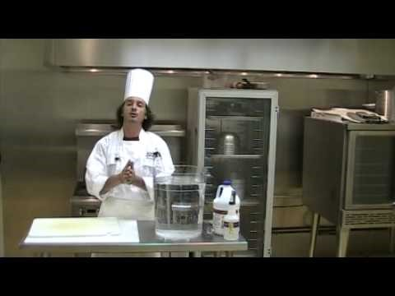
FAT TOM

Slide 4
FAT TOM
F – food: high protein or carbohydrate
A – acidity: low acid foods, pH between 4 and 7
T – time: max 2 hours in the temp danger zone
T- temperature: 40 to 140 degrees
O – oxygen: need oxygen
M – moisture: high moisture foods

Slide 5
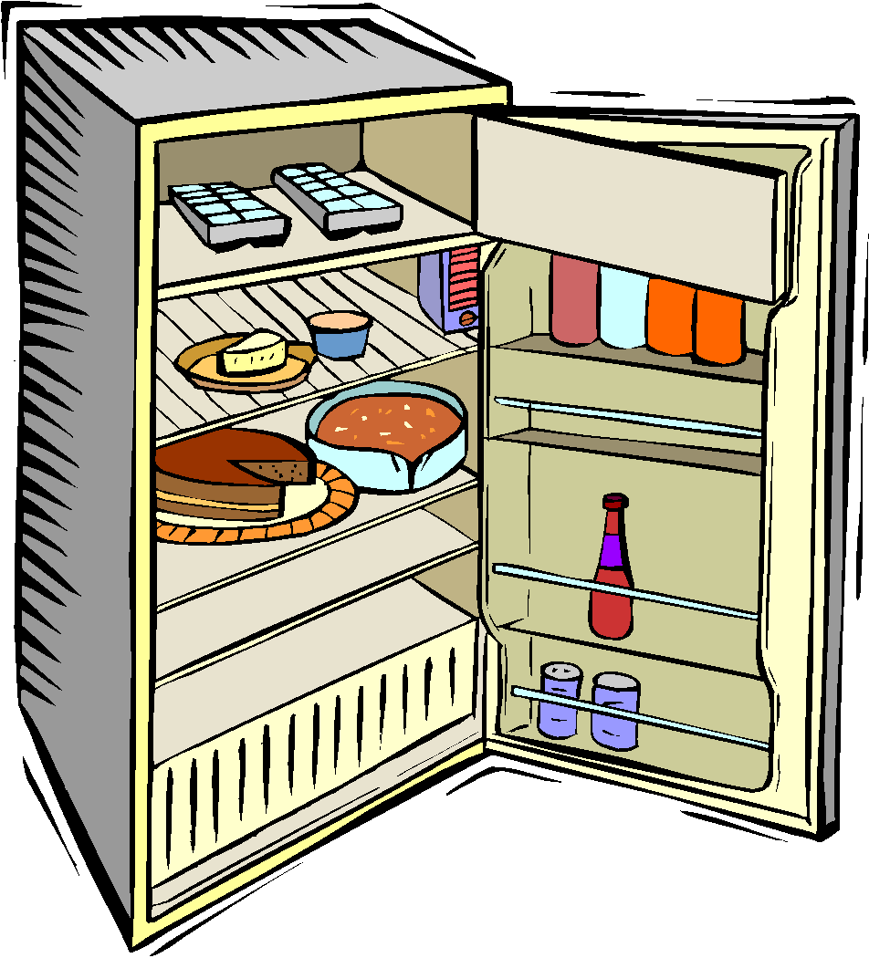
Food Storage www.stilltasty.com
Meat, Fish, Poultry Product | Refrigerator | Freezer
1. Fresh Ground Beef | Raw 1-2 days in original pkg Cooked 3-4 days | Raw: Overwrap original pgk w/foil, plastid wrap, or freezer paper, indefinitely stored Cooked: 3 months
2.
3.
4.
Copyright © Notice: The materials are copyrighted © and trademarked ™ as the property of The Curriculum Center for Family and Consumer Sciences, Texas Tech University.
Notes:
5

Slide 6
How do time and temp affect food safety?
Freezing or refrigerating foods will slow or stop the growth of bacteria, but will not kill bacteria.
Maintaining foods at temperatures of 140°F or above will also stop the growth of organisms.
The only way to kill bacteria is by thoroughly cooking the food.
By limiting the time that these foods are in this danger zone, bacteria are not given enough time to grow and make us sick.

Slide 7
Why should raw animal products be cooked thoroughly?
Some of these products may be contaminated with microbes from the very beginning (salmonella in eggs)
Other products may become contaminated when they are slaughtered and processed (E. coli O157:H7 in ground beef)
Food products that come from animal sources should always be properly cooked (even cookie dough).
Notes:
https://www.youtube.com/watch?v=JXZQPATYTO4
7

Slide 8
Thawing Foods
Risky foods should never be thawed at room temperature
Risky foods should be thawed either in the refrigerator or in the microwave.
Do not thaw foods by putting in a sink with standing water – it is not safe.

Slide 9
Cooling Foods
Do not allow hot foods to cool at room temperature before putting them in the refrigerator or freezer.
Put foods into smaller containers and then refrigerate.
When placing hot food in the refrigerator, don’t cover foods tightly until after they are cooled, it traps the steam inside.
Chill large containers of hot food in an ice bath in the kitchen sink and stir often.

Slide 10
Reheating Foods
Reheating should be done quickly (not in slow cookers or crock pots) and should only be done once.
Each time risky foods pass through the danger zone, the chance for bacteria to grow and cause problems is increased.
Foods should be thoroughly reheated to kill off bacteria that might have grown during the cooling process.
If risky foods are left out at room temperature for more than two hours, they should no longer be considered safe to eat and should be thrown away.

Slide 11
Apply the Heat
Look Up: FDA Minimum Cooking Temperatures
On the printout titled Apply the Heat, label the foods with the correct temperatures
Label the Temperature Danger Zone
Label temp to hold cold foods
Label temp to hold hot foods

