Slide 1
Warm-Up – Knife Skills
In your notebooks answer the questions
What are knife skills and why is it important to have good knife skills?

Slide 2
Basic Knife Skills
Safety & Sanitation Unit

Slide 3
Work Area Set Up:
1. Sanitize work area.
2. Stabilize cutting board by placing a damp dish cloth under it to prevent movement.
3. Set up bowls to use for waste and for useable product.

Slide 4
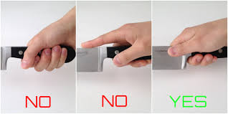
Holding a Chef’s knife:
Hold knife with fingers around the handle with thumb and index finger on the metal of the blade.
NO fingers under the blade!
Do not point finger over the spine.

Slide 5
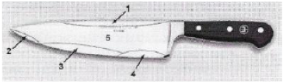
The Chef’s Knife
The Most Important Kitchen Tool
1. The sturdy spine of the blade can be used to break up small bones or shellfish.
2. The tip of the blade is suitable for many small cutting jobs. It is particularly useful for chopping onions, mushrooms, garlic, and other small veggies.
3. The mid-section of the blade is great for either firm or soft food. The gentle curve of the blade is ideal for mincing of leeks, chives, herbs, etc.

Slide 6
The Chef’s Knife
The Most Important Kitchen Tool
4. The weight distribution is optimal at the heel of the blade and is used to chop through extremely firm food products.
5. The wide flat surface of the blade is suitable for flattening and shaping of meat cuts such as filets as well as for lifting/moving of the chopped product. Can be used to smash garlic prior to mincing.

Slide 7
Knife Safety
1. Keep knives sharp. Dull knifes are more dangerous than sharp knives.
2. Always use a cutting board.
3. Pay attention.
4. Cut away from yourself and others.
5. Use knives only for cutting.
6. Don’t catch a falling knife.
7. Don’t leave knives in the sink.
8. Clean knives carefully with the sharp edge away from you.
9. Store knives in a safe place, not in drawers.
10. Carry a knife properly:
  Hold it beside you, point down, sharp edge back and away from you
  Don’t swing your arm
  Let people know you are walking past them with a knife. VERY IMPORTANT!

Slide 8
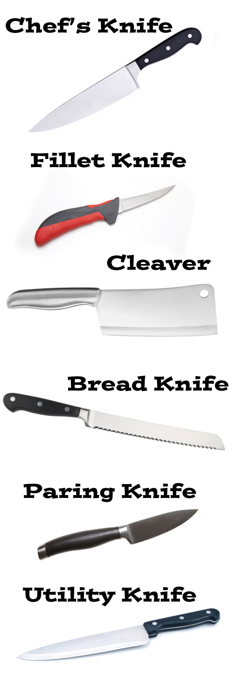
Why Different Knives are Needed
Cutting different types of food requires different types of knives. There is no universal knife for the multitude of cutting tasks.
The chef’s knife is ideal for all food preparations including mincing, dicing, and slicing. It is the manual food processor.
Fillet knife used for filleting fish and is flexible for deboning.
A cleaver is ideal for chopping bones or very tough meat or veg.
Slicing bread, ripe tomatoes, or a crispy roast a knife with a serrated edge such as a bread knife is the right tool.
In order to peel or cut small veg and fruit a small blade or paring knife is used.
Utility knife is a general purpose knife, not great for precision.
A carving knife with a long and straight edge is ideal for carving.
Carving Knife

Slide 9
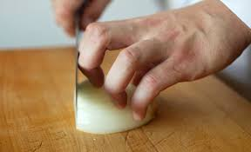
Claw Grip
Claw Grip - Keep fingers curled inward and grip the food with the fingernails so that fingers stay out of harm's way. The side of the knife blade actually rests against the first knuckle of the guiding hand, which helps keep the blade perpendicular to the cutting board.

Slide 10
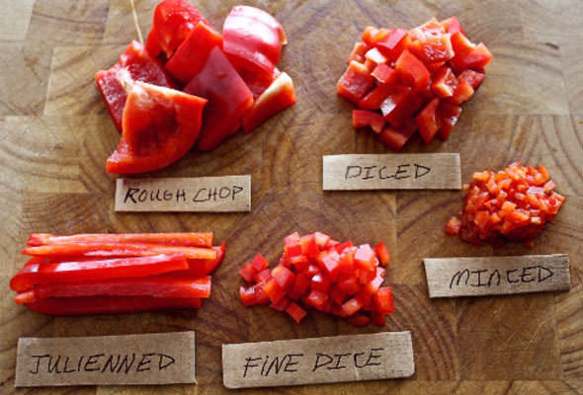
Basic Knife Cuts

Slide 11
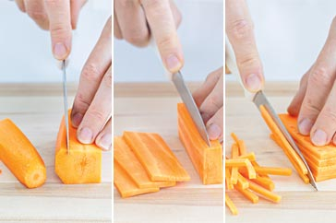
Basic Knife Cuts – Julienne
Looks like a matchstick
Step 1: Trim the veg so that the sides are straight, making it easier to produce even cuts.
Step 2: Slice the veg lengthwise to 1/8 in. thickness using parallel cuts.
Step 3: Stack the slices and make even parallel cuts to produce a series of batons.
Step 4: The finished result is a series of batons 1/8 in. x 1/8 in. x 1-2 in.

Slide 12
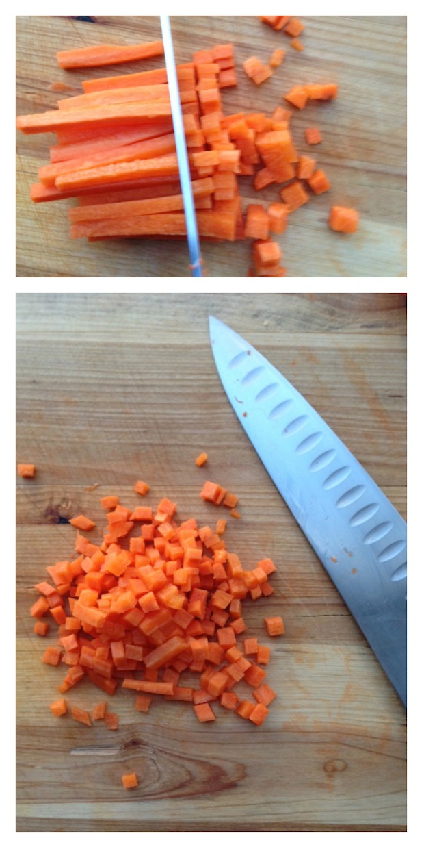
Basic Knife Cuts – Brunoise
Step 1: Prepare the veg as you would for Julienne making sure all sides are straight.
Step 2: Slice veg lengthwise into 1/8 in. slices using a series of parallel slices.
Step 3: Stack and cut each slice into 1/8 in. batons.
Step 4: Using a series of parallel cuts, cut each baton into 1/8 in. cubes.

Slide 13
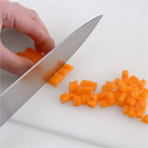
Basic Knife Cuts – Small Dice
Step 1: Trim the veg so that the sides are straight, making it easier to produce even cuts.
Step 2: Slice the veg lengthwise to 1/4 in. thickness using parallel cuts.
Step 3: Stack the slices and make even parallel cuts to produce a series of batons ¼ in thick. .
Step 4: Using a series of parallel cuts, cut each baton into 1/4 in. x 1/4 in. cubes

Slide 14

Basic Knife Cuts – Medium Dice
Same process as small dice
½ in. x ½ in. cubes

Slide 15
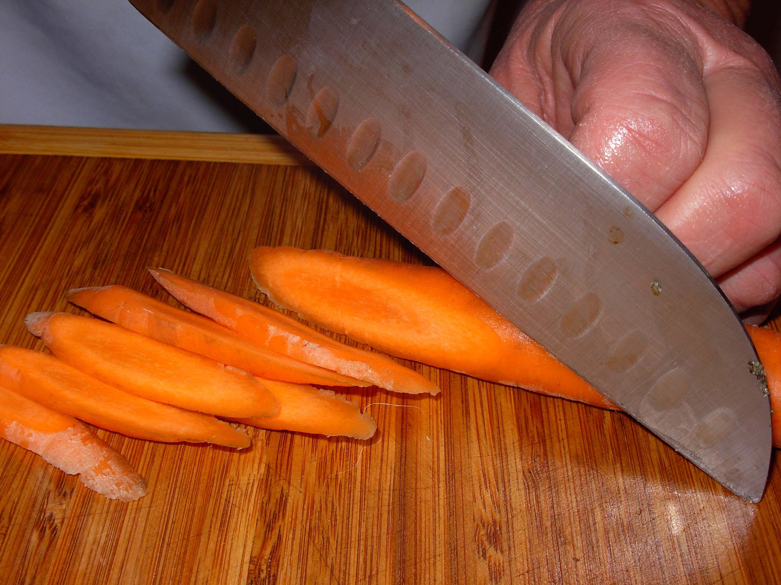
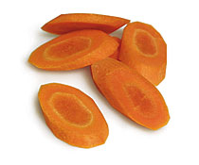
Basic Knife Cuts – Diagonal (Bias)
Diagonal cutting is a simple Chinese cooking technique that can used with many vegetables.
Cutting vegetables on the diagonal exposes more of the vegetable's surface area to the heat.
Besides making the vegetable cook more quickly, it allows it to absorb more of the sauces and seasonings it is cooked with.

Slide 16
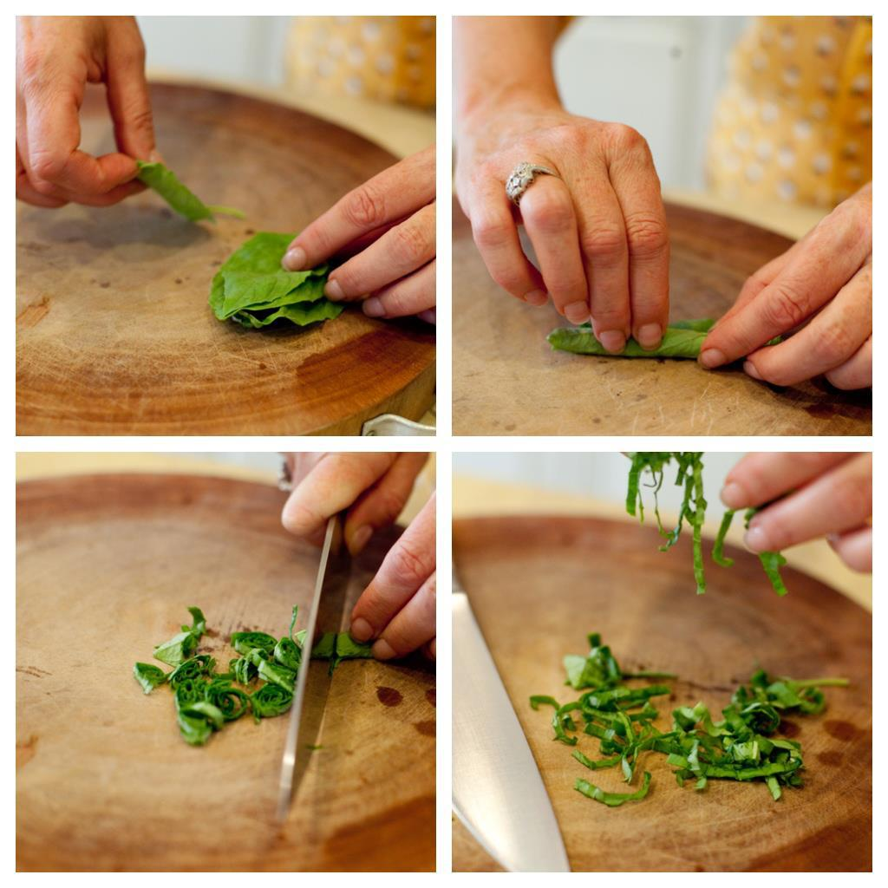
Basic Knife Cuts – Chiffonade
Step 1: Wash and dry leaves awell.
Step 2: Carefully remove any stalks.
Step 3: Stack and roll the leaves into a cylinder.
Step 4: Slice crosswise into 1/8 inch strips.

Slide 17
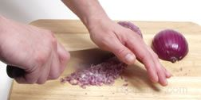
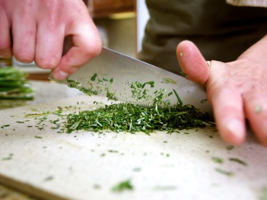
Basic Knife Cuts – Mince
Mince – to cut food into very fine pieces.
Use a chef’s knife and keep guiding hand on the spine with fingers out of the way.

Slide 18
Vegetables and Dip Lab
Carrots and celery - julienne (1/8 x 1/8 x 2 in. in length), then cut one of the julienne into brunoise (1/8 x 1/8 x 1/8).
Create an example of a small dice (1/4 x 1/4 x 1/4) and medium dice ( 1/2 x 1/2 x 1/2) as well
Cucumber - diagonal cut 1/4" in width.
Spinach leaves – chiffonade and mince
Save your best cut for evaluation prior to eating.

